Slide 1
Top 5 business Hotels in Novara

Slide 2
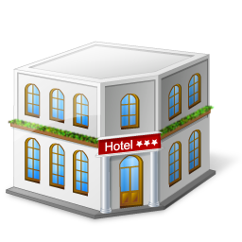
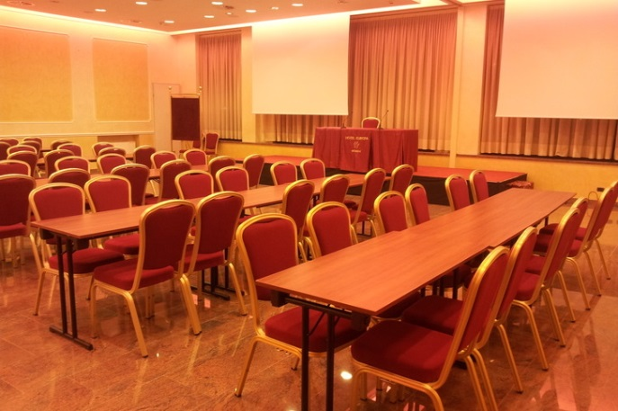
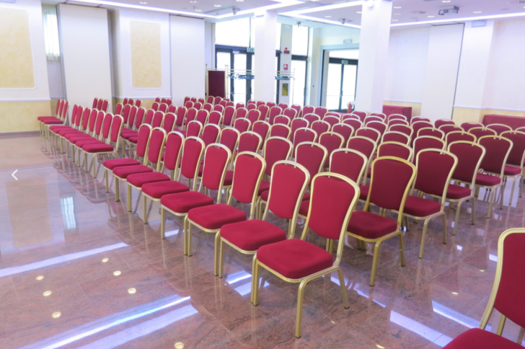
Hotel europa Corso Felice Cavallotti, 38 - Novara (NO)
Information
Number of rooms | 8 meeting rooms: Leone-Ariete-Sagittario, Gemelli, Scorpione, Pesci-Acquario, Toro, Capricorno, Acquario and Pesci rooms.
Capacity | Max: 200 guests, 200 m² Min: 15 guests, 60 m²
Facilities | Modular rooms , high tech equipment, RGB lights, dark curtains, loading and unloading direct road, halide lighting, air conditioning with air exchange-
Prices | Leone, Ariete, Sagittario: 500€ per day Gemelli: 350€ per day Pesci/Acquario: 450€ per day (350€ half day) Scorpione: 350€ per day (250€ half day) Toro: 180€ per day (130€ half day) Acquario and Pesci rooms: 300€ per day (240€ half day) Capricorno: 150€ per day (100€ half day)

Slide 3
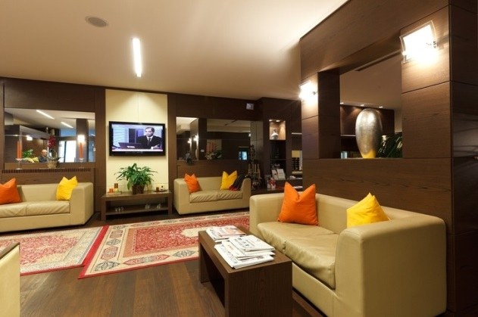
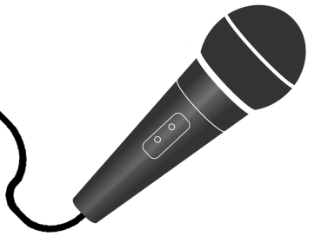
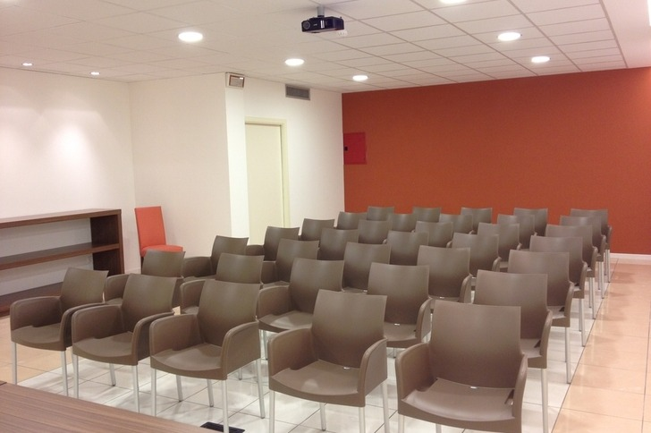
Hotel Villa delle Rose Via Gallarate 136 - Oleggio (NO)
Information
Number of rooms: | 2 meeting rooms: Sala meeting and Saletta Bar
Capacity: | Max:40 guests Min: 25 guests, 25 m²
Facilities: | Videoprojector, flip-chart, audio system and Wi-Fi connection, 50-inch TV for PC projection, sheets and pens.
Prices: | Sala meeting: 89€ per day Saletta Bar: 69€ per day

Slide 4
Hotel la bussola Via Boggiani 54, Novara
Information
Number of rooms | Broletto is the complete meeting hall, it is composed by 5 meeting rooms divided by moving walls
Capacity | From 15 to 250 guests
Facilities | Secretary desk, wardrobe Optical fibre connection wi-fi free From 1 to 4 projector model EPSON EB-W03 resolution WXGA, zoom optical 1,2x e White e Colour Light Output di 2.700 lumen PC connection VGA/HDMI Audio connection (On request) Fixed microphone, handheld microphone (On request) Podium (On request)
Prices | Ask for a quotation

Slide 5
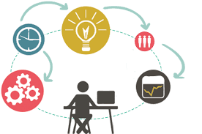
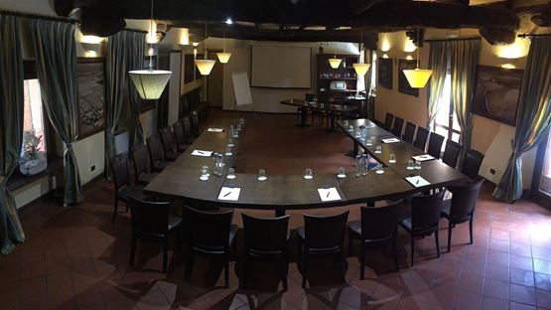
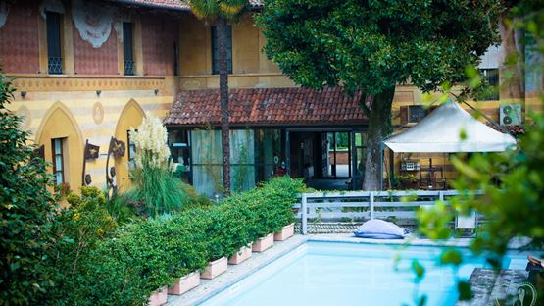
TENIMENTO AL CASTELLO RESORT Sillavengo, Via San Giuseppe, 15(NO)
Information
Number of rooms | 3: Sala Colonne, Sala Foresteria e Sala Q33.
Capacity | From 100 to 180 guests
Facilities | Flip chart, Mobile stage, PC, Built-in screen, Mobile screen Video projector, coffee break, light lunch and dinner
Prices | Ask for a quotation

Slide 6
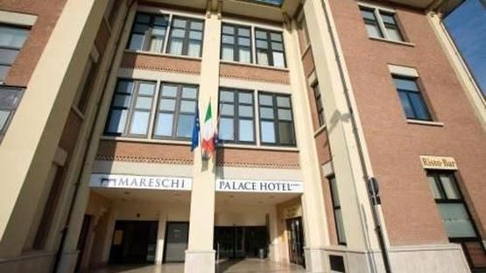
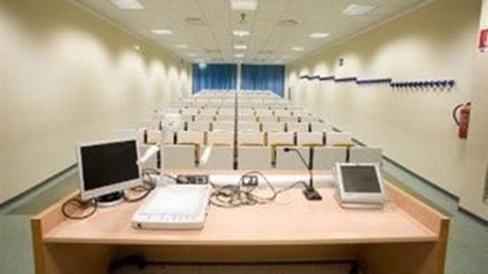
BELLA ITALIA PALACE HOTEL Largo Donegani, 6 Novara
Information
Number of rooms | 2: Meeting room 1 and 2.
Capacity | From 80 to 200 guests
Facilities | Free wifi,Voice and sound amplification, Flip chart, Built-in screen, Video projector.
Prices | Ask for a quotation

